Slide 1
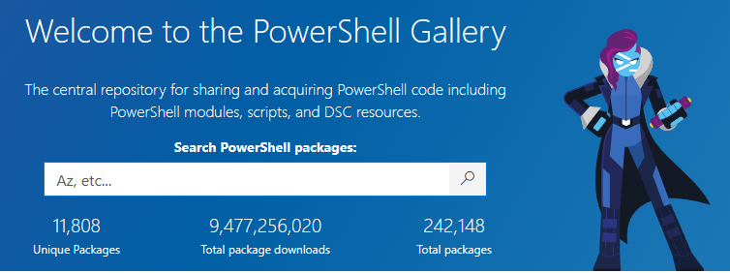
Publishing a module to the PowerShell Gallery

Slide 2
PowerShell Gallery Account
Go
Go to https://www.powershellgallery.com and click on Sign in.
Select
Select the account you want to use and sign in.
Create
Create a username for the PowerShell Gallery, review the Terms of Use and Privacy Policy, then click Register.

Slide 3
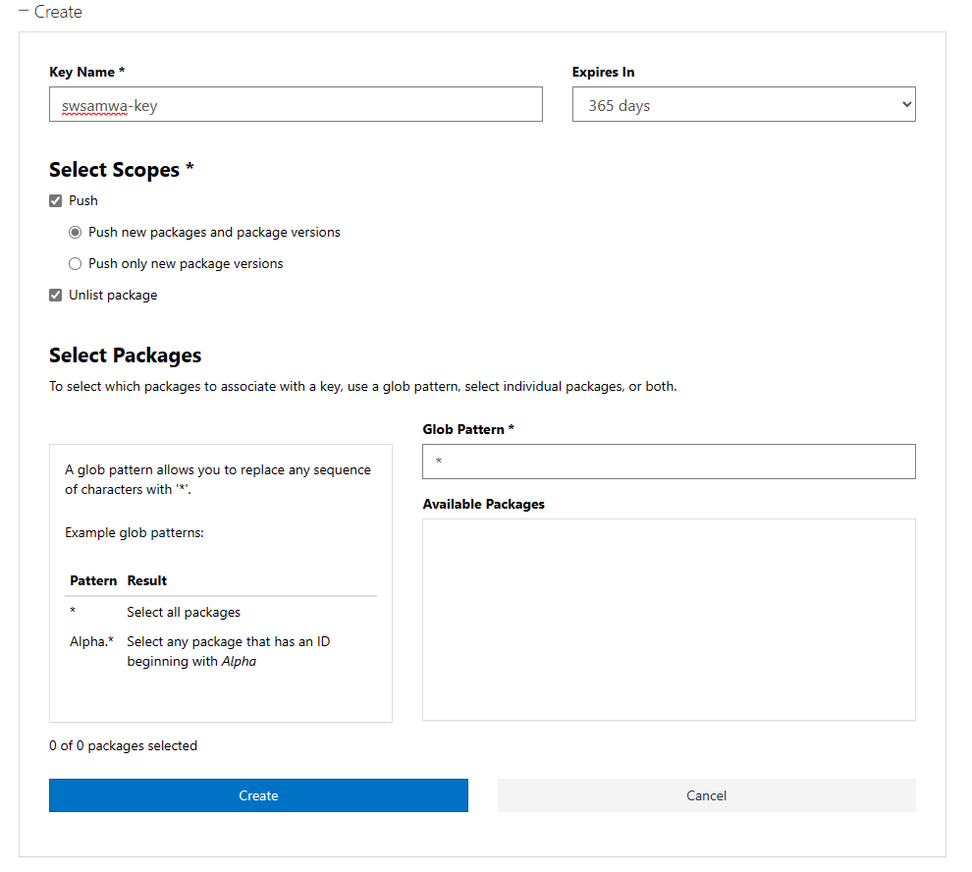
Create API Key
Click on your username and select API Keys from the menu.
Select +Create to create a new key.
Select the options you want and select the Create button.

Slide 4
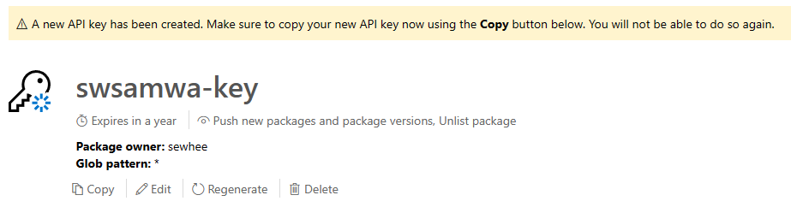
Save your API Key
Click the Copy button and save the key in a safe place.

Slide 5

Module manifest metadata
Required
Module Name – Based on the name of the .PSD1 file
Version - format should follow SemVer guidelines
Author - name of the author/ownerRecommended
Description - briefly explain what the module does and any requirements
Recommended
PSData.ProjectUri – a link your source code
PSData.LicenseUri – a link to the license for your code
PSData.Tags – tags indicating PSEdition and platform support, and other keywords

Slide 6

Test your module and metadata
Use PowerShell Script Analyzer to ensure code quality
Test your code thoroughly
Run Test-ModuleManifest

Slide 7

Publish to the PowerShell Gallery
Requirements
Path to the module
PowerShell Gallery API Key
After publishing
Check the item in the Gallery
Unlist/List as needed
Adjust information in the Gallery UI as necessary

